Slide 1







OLD HAM COUPLING MECHANISM
TOM MINI PROJECT
Presenting by:
David Ojha
Apar Jung Thapa
Sirish Shrestha
Presenting To:
Associate. Prof. Binaya Kc

Slide 2
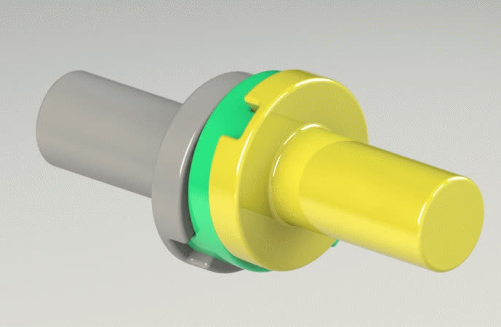
BACKGROUND
Oldham's Coupling was invented by the Irish engineer John Oldham. It is a mechanical coupling used to connect two parallel shafts that have slight lateral misalignment while maintaining constant rotational speed.
It is used to connect two parallel shafts with slight lateral misalignment.
Provides a constant 1:1 angular velocity ratio.
Consists of two flanges and a floating intermediate disc.
Commonly used where accurate power transmission is required.

Slide 3
OBJECTIVES
Study the working principle and kinematics of Oldham's Coupling.
Design the geometry and dimensions of the coupling.
Fabricate a functional prototype.
Evaluate its ability to accommodate parallel shaft misalignment.

Slide 4
APPLICATIONS
CNC machines
Servo motor and lead screw systems
Robotic mechanisms
Printing machines
Textile machinery
Precision measurement systems
Rotary motion transmission in industrial equipment

Slide 5
SCOPE AND LIMITATIONS
Scope
Constant torque transmission.
Handles slight parallel shaft misalignment.
Compact, economical, and easy to maintain.
Suitable for low to medium torque applications.
Limitations
Cannot accommodate angular or axial misalignment.
Sliding action causes wear and friction.
Performance decreases at high rotational speeds.
Prototype limited to functional demonstration only.

Slide 6
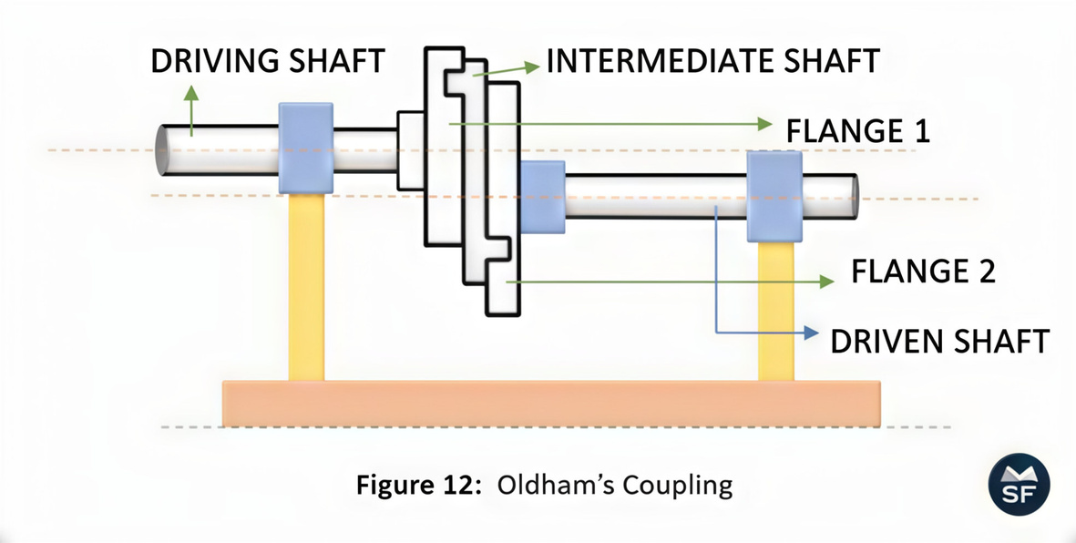
COMPONENTS
1. Input Flange
Mounted on the driving shaft.
Transfers motion to the intermediate disc.
2. Intermediate Disc
Floating member.
Contains tongues on both sides placed at 90°.
Slides inside the grooves of both flanges.
3. Output Flange
Mounted on the driven shaft.
Receives motion from the intermediate disc.

Slide 7
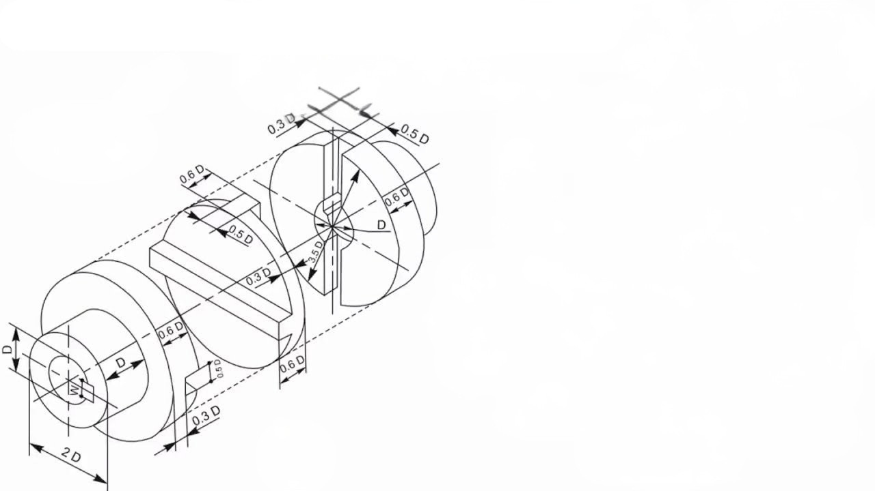
WORKING PRINCIPLE
Input shaft rotates.
Input flange drives the floating disc.
Floating disc slides inside the groove.
Output flange receives motion.
Output shaft rotates at the same speed.
Sliding motion compensates for shaft misalignment.

Slide 8
THEORITICAL FRAMEWORK
Oldham's coupling works based on kinematic principles.
It is considered an RP–PR mechanism, which is an inversion of the Elliptic Trammel mechanism.
Important Design Parameters
Shaft offset distance
Groove radius
Radius of curvature
Groove intersection angle (approximately 90°)
Mechanical Considerations
Sliding motion causes friction.
Larger groove radius reduces wear.
Higher speed increases vibration and dynamic imbalance.
These parameters directly affect the efficiency and life of the coupling.

Slide 9
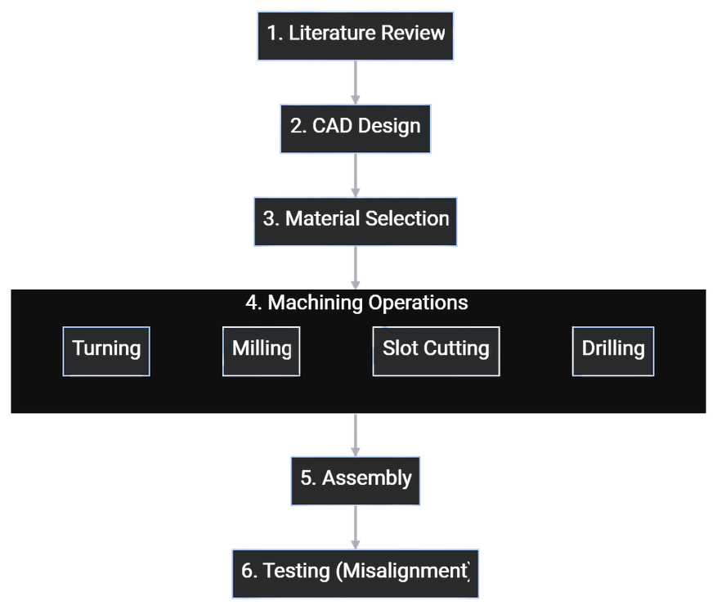
DESIGN AND FABRICATION PROCESS

Slide 10
ADVANTAGE
Constant velocity transmission.
Handles slight parallel misalignment.
Compact design.
Low manufacturing cost.
Easy assembly.
Easy maintenance.
Smooth power transmission.
Suitable for precision applications.
Simple construction.

Slide 11
CONCLUSION
The design and fabrication of the Oldham's Coupling successfully demonstrated constant velocity transmission between two parallel misaligned shafts. The prototype validated the working principle of the coupling and provided practical knowledge of mechanical design, fabrication, assembly, and testing, reinforcing the theoretical concepts learned in the Theory of Machines course.

Slide 12
FUTURE WORKS
Future work can include high-speed performance testing, vibration and stress analysis using FEA, wear and fatigue evaluation, and testing under different loading conditions. Using improved materials or self-lubricating components can further enhance the coupling's durability and efficiency.

Slide 13
THANK YOU!

Slide 14
REFERENCES
OLDHAM, J. – HISTORICAL DEVELOPMENT OF OLDHAM'S COUPLING.
NORTON, R. L. DESIGN OF MACHINERY.
SHIGLEY & MISCHKE. MECHANICAL ENGINEERING DESIGN.
RATTAN, S. S. THEORY OF MACHINES.
KHURMI & GUPTA. THEORY OF MACHINES.

Slide 15


APPENDIX

